Slide 1
Functional Dependencies and Normalization for Relational Databases
Chapter 5

Slide 2
Relational database design
In Relational Model, each relation schema consists of a number of attributes, and the relational database schema consists of a number of relation schemas.
Conceptual data models such as the ER or Enhanced-ER (EER) model or some other conceptual models make the designer to identify entity types and relationship types and their respective attributes, which leads to a natural and logical grouping of the attributes into relations.
Relational database design is the grouping of attributes to form "good" relation schemas.

Slide 3
There are two levels at which we can discuss the goodness of relation schemas.
The first is the logical (or conceptual) level—how users interpret the relation schemas and the meaning of their attributes.
Having good relation schemas at this level enables users to understand clearly the meaning of the data in the relations, and hence to formulate their queries correctly.
The second is the implementation (or physical storage) level—how the tuples in a base relation are stored and updated which will be physically stored as files.

Slide 4
Informal Design Guidelines for Relation Schemas
There are four informal measures that may be used as measures to determine the quality of relation schema design: they are
Making sure that the semantics of the attributes is clear in the schema.
Reducing the redundant information in tuples.
Reducing the NULL values in tuples.
Disallowing the possibility of generating spurious tuples.

Slide 5
Clear Semantics to Attributes in Relations
The semantics of a relation refers to the interpretation of attribute values in a tuple.
Whenever the attributes are grouped to form a relation schema, it is assumed that attributes belonging to one relation have certain real-world meaning and a proper interpretation associated with them.
Attributes of different entities (EMPLOYEEs, DEPARTMENTs, PROJECTs) should not be mixed in the same relation
Only foreign keys should be used to refer to other entities
Entity and relationship attributes should be kept apart as much as possible.

Slide 6
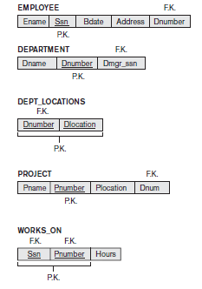
Consider a simplified version of the COMPANY relational database schema as shown in the below given figure.

Slide 7
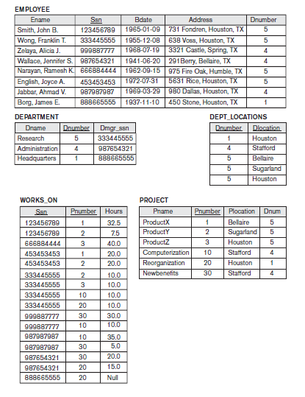
Now, consider the following diagram, which represents an example of populated relation states of the above schema as shown below.

Slide 8

The meaning of the EMPLOYEE relation schema is quite simple: Each tuple represents an employee, with values for the employee’s name (Ename), Social Security number (Ssn), birth date (Bdate), and address (Address), and the department number that the employee works for (Dnumber).
The Dnumber attribute is a foreign key that represents an implicit relationship between EMPLOYEE and DEPARTMENT.
The semantics of the DEPARTMENT and PROJECT schemas are also straightforward: Each DEPARTMENT tuple represents a department entity, and each PROJECT tuple represents a project entity.
The attribute Dmgr_ssn of DEPARTMENT relates a department to the employee who is its manager, while Dnum of PROJECT relates a project to its controlling department; both are foreign key attributes.
The ease with which the meaning of a relation’s attributes can be explained is, an informal measure of how well the relation is designed.

Slide 10
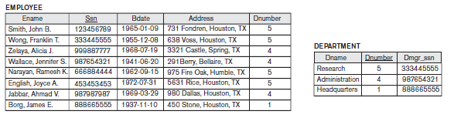
Reducing Redundant Information in Tuples
Information is stored redundantly and it causes Wastes storage.
Consider the two base relations EMPLOYEE and DEPARTMENT as shown in the figure below.

Slide 11
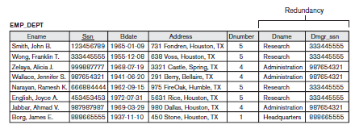
Now, consider an EMP_DEPT base relation as shown in the below diagram which is the result of applying a NATURAL JOIN operation to EMPLOYEE and DEPARTMENT in the above diagram.

Slide 12
In EMP_DEPT, the attribute values pertaining to a particular department (Dnumber, Dname, Dmgr_ssn) are repeated for every employee who works for that department.
In contrast, each department’s information appears only once in the DEPARTMENT relation in the first figure (shows the EMPLOYEE and DEPARTMENT relation separately).
Only the department number (Dnumber) is repeated in the EMPLOYEE relation for each employee who works in that department as a foreign key.

Slide 13
Another problem with using the relations in figure above (which shows the EMP_DEPT base relation) is the problem of update anomalies.
These can be classified into;
Insertion anomalies
Deletion anomalies and
Modification anomalies.

Slide 14
Insertion Anomalies
An “insertion anomaly” is a failure to place information about a new database entry.
For ex: to insert a new tuple for an employee who works in department 5, into the above drawn EMP_DEPT relation, we must enter the attribute values for the department also.
Also, it is difficult to insert a new department that has no employees as yet in the EMP_DEPT relation.
The only way to do this is to place NULL values in the attributes for employee.
This causes a problem because Ssn is the primary key of EMP_DEPT, and each tuple is supposed to represent an employee entity-not a department entity.

Slide 15
Cont’d
The above mentioned problem does not occur in the design of the figure (which shows EMPLOYEE and DEPARTMENT as two different relations) because a department is entered in the DEPARTMENT relation whether or not any employees work for it, and whenever an employee is to be added, it will be done in EMPLOYEE relation only.

Slide 16
Deletion Anomalies
A “deletion anomaly” is a failure to remove information about an existing database entry.
Additionally, deletion of one data may result in lose of other information.
For ex: if an employee tuple (that happens to be the last employee working for a particular department) is deleted from EMP_DEPT, the information concerning that department is lost from the database.

Slide 17
Modification Anomalies
A “modification anomaly” is a failure to modify/update information about an existing database entry.
For ex: In EMP_DEPT of the above figure, if we change the value of one of the attribute of a particular department—say, the manager of department 5—we must update the tuples of all employees who work in that department; otherwise, the database will become inconsistent.

Slide 18


Slide 19
NULL values in tuples
Reasons for nulls:
Attribute not applicable or invalid
Attribute value unknown (may exist)
Value known to exist, but unavailable
Relations should be designed such that their tuples will have as few NULL values as possible
Attributes that are NULL frequently could be placed in separate relations (with the primary key)

Slide 20
Cont’d
In some schema designs, if many of the attributes do not apply to all tuples in the relation, we end up with many NULLs in those tuples.
This can waste space at the storage level and may also lead to problems with understanding the meaning of the attributes.
Also, another problem with NULL is how to account aggregate operations such as COUNT or SUM.
As far as possible, avoid placing attributes in a base relation whose values may frequently be NULL.
If NULLs are unavoidable, make sure that they apply in exceptional cases only and do not apply to a majority of tuples in the relation.

Slide 21
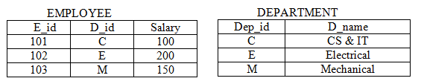
Generation of spurious tuples
Consider two base relations EMPLOYEE and DEPARTMENT as given below

Slide 22
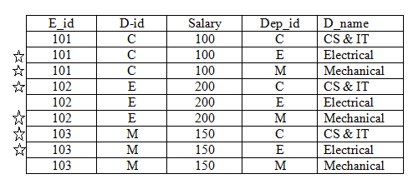
If we attempt to JOIN (Cartesian product) the above relations, the following relation will be occurred.

Slide 23
In the above relation, you can observe that there are some meaningless tuples (which are called as spurious tuples).
For ex: consider the second tuple in the above relation. It shows that an employee with E_id = 101, is getting a salary of 100, belongs to CS & IT and Electrical department also.
This is clearly spurious information, since one employee cannot belong to two departments. So, this tuple will be a spurious tuple and is marked by asterisks (*).
To obtain the correct data, we have to apply conditions on the JOIN operation. For ex: if the condition is as
EMPLOYEE . E_id = DEPARTMENT . Dep_id
We will be retrieving the only the tuples 1, 5 and 9 only, which is the required one.

Slide 24
Functional Dependency
In general, a functional dependency is a relationship among attributes.
It is the relationship that exist when one attribute uniquely determine another attribute.
A set of attributes X functionally determines a set of attributes Y if the value of X determines a unique value for Y.
X  Y holds if whenever two tuples have the same value for X, they must have the same value for Y
For any two tuples t1 and t2 in any relation instance r(R): If t1[X]=t2[X], then t1[Y]=t2[Y]

Slide 25
Cont’d
From the Student Relation identify FD
R.No | Name | Mark | Dept | Courses
1 | A | 78 | CS | C1
2 | B | 60 | SE | C1
3 | A | 78 | CS | C2
4 | B | 60 | SE | C3
5 | C | 80 | IT | C3
6 | C | 80 | EE | C2
X Y
R.No Name (Yes)
Name R.No (Not)
R.No Mark (Yes)
Dept Course(Not)
R.No, Name Mark (Yes)

Slide 26
Data Dependency
The logical associations between data items that point the database designer in the direction of a good database design are referred to as determinant or dependent relationships.
Two data items A and B are said to be in a determinant or dependent relationship if certain values of data item B always appears with certain values of data item A.
If the data item A is the determinant data item and B the dependent data item, then the direction of the association is from A to B and not vice versa.

Slide 27
The essence of this idea is that if A exists, implies that B must exist and have a certain value, and then we say that "B is functionally dependent on A."
Also it is possible to say that "A functionally determines B," or that "B is a function of A," or that "A functionally governs B" or "If A, then B.“

Slide 28
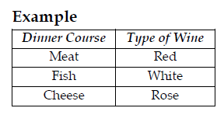
Since the type of Wine served depends on the type of Dinner, we say Wine is functionally dependent on Dinner. ie,
Example2: Student Relation
SID | SName | SDept
1 | Henok | CS
2 | Kalkidane | IT
3 | Tamiru | SE
4 | Henok | SE
SID Sname
SID SDept

Slide 29
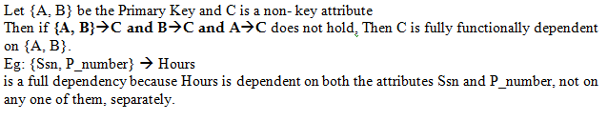
Full Dependency
If an attribute which is not a member of the primary key is dependent on the whole key and not on some part of the primary key, then that attribute is fully functionally dependent on the primary key.

Slide 30

Partial Dependency
If an attribute which is not a member of the primary key is dependent on some part of the primary key, then that attribute is partially functionally dependent on the primary key.
Let {A,B} is the Primary Key and C is no key attribute.

Slide 31

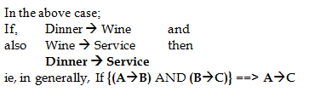
Transitive Dependency
In mathematics and logic, a transitive relationship is a relationship of the following form: "If A implies B, and if also B implies C, then A implies C.“
Example:

Slide 32
NORMALIZATION

Slide 33
A relational database is merely a collection of data, organized in a particular manner.
Database normalization is a series of steps followed to obtain a database design that allows for consistent storage and efficient access of data in a relational database.
Concept of normalization was introduced by Edgar.F. Codd (known as the father of the relational data model)as the basis for database design.
He defined first, second and third normal forms depending upon the constraints which each normalization form satisfies.
Normalization is used to avoid redundancy and the problems arising out of redundancy.

Slide 34
Normalization is the process of identifying the logical associations between data items and designing a database that will represent such associations but without any type of anomalies.
Normalization may reduce system performance since the data will be cross referenced from many tables.
Thus de-normalization is sometimes used to improve performance, at the cost of reduced consistency guarantees.

Slide 35
Steps of Normalization
We have various levels or steps in normalization called Normal Forms.
The level of complexity, strength of the rule and decomposition increases as we move from one lower level Normal Form to the higher.
A table in a relational database is said to be in a certain normal form if it satisfies certain constraints.

Slide 36
Normalization towards a logical design consists of the following steps:
UnNormalized Form (UNF): Identify all data elements
First Normal Form (1NF): Find the key with which you can find all data i.e. remove any repeating group
Second Normal Form (2NF): Remove part-key dependencies (partial dependency). Make all data dependent on the whole key.
Third Normal Form (3NF): Remove non-key dependencies (transitive dependencies). Make all data dependent on nothing but the key.
For most practical purposes, databases are considered normalized if they adhere to the third normal form (there is no transitive dependency).

Slide 37
First Normal Form (1NF)
A relation is said to be in first normal form (INF) if and only if all underlying domains contain atomic values only.
i.e it states that the domain of an attribute must include only atomic values (simple, indivisible) and that the value of any attribute in a tuple must be a single value from the domain of that attribute.
It does not allows Composite attributes and Multivalued attributes
1NF Rules
No repeating group
Create Separate table for each set of data
Create primary key for each set of data

Slide 38
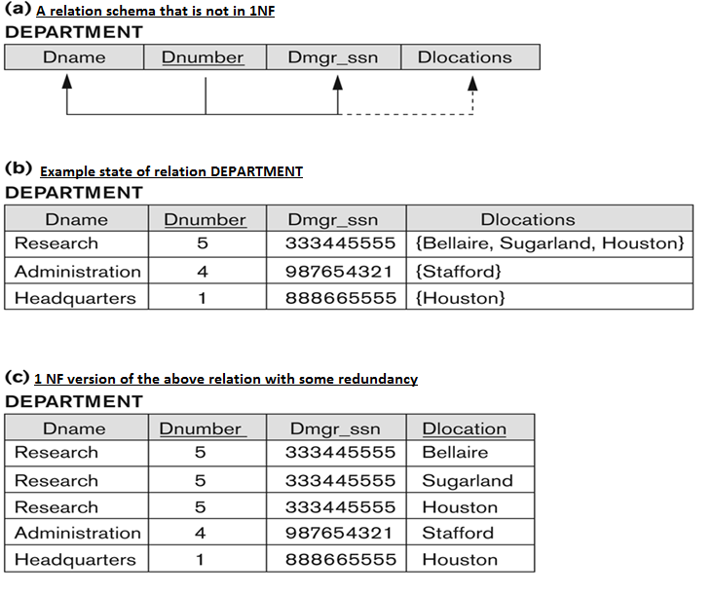
The following diagram depicts the steps of normalization into 1NF form

Slide 39
Second Normal form (2NF)
No partial dependency of a non key attribute on part of the primary key. This will result in a set of relations with a level of Second Normal Form.
Definition: A table (relation) is in 2NF, if
It is in 1NF, and
If all non-key attributes are dependent on the entire primary key. i.e. no partial dependency.
That means, a relation R is said to be in 2NF if it is in 1NF and every non key attribute is completely functionally dependent on the primary key of R.
2NF Rules
No Redundancy
Break many to many relationship

Slide 40
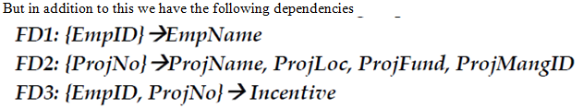
Example for 2NF:
Consider the relation schema given below.
Business rule: Whenever an employee participates in a project, he/she will be entitled for an incentive.
This schema is in its 1NF since we don‘t have any repeating groups or attributes with multi-valued property. To convert it into a 2NF, we need to remove all partial dependencies of non key attributes on part of the primary key.

Slide 41
As we can see, some non key attributes are partially dependent on some part of the primary key.
This can be witnessed by analyzing the first two functional dependencies (FD1 and FD2).
Thus, each Functional Dependencies, with their dependent attributes should be moved to a new relation (as shown in the below diagram) where the determinant will be the Primary Key for each.

Slide 42
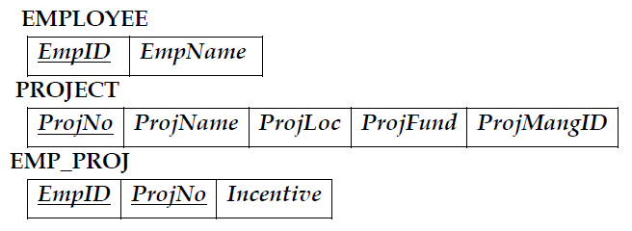
Cont’d

Slide 43
Third Normal Form (3NF)
Eliminate Columns dependent on another non-Primary Key - If attributes do not contribute to a description of the key; remove them to a separate table.
This level avoids update and deletes anomalies.
Definition: A Table (Relation) is in 3NF, if:
It is in 2NF , and
There are no transitive dependencies between a primary key and non-primary key attributes.

Slide 44
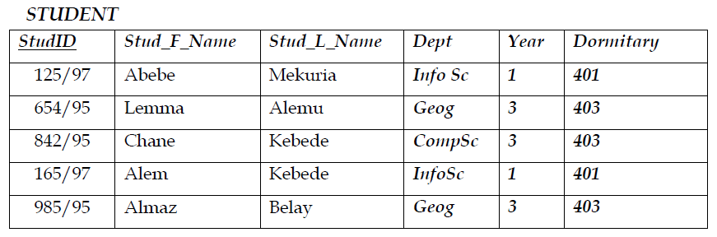
Example for (3NF)
Assumption: Students of same batch (same year) live in the same dormitory
This schema is in its 2NF since the primary key is a single attribute and there are no repeating groups (multi valued attributes).

Slide 45
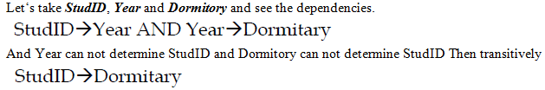
To convert it into a 3NF, we need to remove all transitive dependencies of non key attributes on another non-key attribute.
The non-primary key attributes, dependent on each other will be moved to another table and linked with the main table using Candidate Key- Foreign Key relationship as shown below.

Slide 46
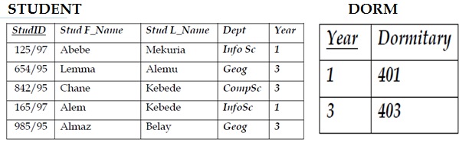
Cont’d

Slide 47
Generally, even though there are other four additional levels of Normalization, a table is said to be normalized if it reaches 3NF.
A database with all tables in the 3NF is said to be Normalized Database.
Tips for remembering the rationale for normalization up to 3NF could be the following:
No Redundancy: no repeating fields in the table.
The Fields depend upon the Key: the table should solely depend on the key.
The Whole Key: no partial key dependency.
And nothing but the Key: no inter data dependency.

Slide 48
Pitfalls of Normalization: Problems associated with normalization
Requires data to see the problems
May reduce performance of the system
Is time consuming
Difficult to design and apply
Prone to human error

Slide 49
Reading Assignment
Refer some text books (from Library)/Internet, for the following other levels of Normalization- Those are as follows:
Boyce-Codd Normal Form (BCNF)
Forth Normal form (4NF)
Fifth Normal Form (5NF)
Domain-Key Normal Form (DKNF)

Slide 50
Thank You

